Slide 1

Mineral Dust Detect Algorithms
Using Satellite Data
Janita Patwardhan¹, Peichang Shi², and Qianqian Song³
Advisors: Dr. Jianwu Wang² and Dr. Zhibo Zhang³
¹Department of Mathematics & Statistics, UMBC
²Department of Information Systems, UMBC
³Department of Physics, UMBC
Acknowledgements: NSF, UMBC, HPCF
CyberTraining: Big Data + High-Performance Computing + Atmospheric Sciences
University of Maryland, Baltimore County, Spring 2018
Notes:
Janita

Slide 2
Outline
Introduction
Data Preparation
Our Algorithms
Conclusion
Notes:
Janita

Slide 3
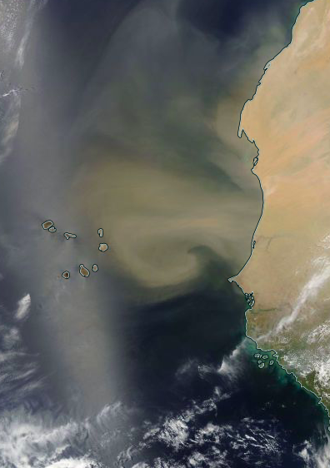
Mineral Dust Aerosol
Defined as soil particles in the air
Adversely affects air quality and human health
Changes temperature structure in the atmosphere
NASA Worldview, May 9 2007: https://go.nasa.gov/2IlNV7r
Notes:
Janita

Slide 4
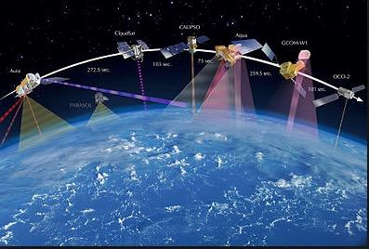
Satellite Data: MODIS and CALIPSO
MODIS:
Passive sensor onboard Aqua and Terra satellite
Images the entirety of the earth every 1-2 days
36 spectral bands
CALIPSO
Satellite with active Lidar sensor
Better able to detect dust by using depolarization
https://en.wikipedia.org/wiki/A-train_(satellite_constellation)
Notes:
Janita

Slide 5
Project Objectives
Collocate the MODIS and CALIPSO data
Develop algorithms using MODIS data to detect dust over ocean
Physically based algorithm
Big data/machine learning algorithm
Design algorithms using MODIS data for detection over land
Physically based algorithm
Big data/machine learning algorithm
Determine accuracy rate of algorithms using CALIPSO data
Compare accuracy of our algorithms to published algorithms
Notes:
Janita

Slide 6
Project Objectives: Achieved
Collocate the MODIS and CALIPSO data
Develop algorithms using MODIS data to detect dust over ocean
Physically based algorithm
Big data/machine learning algorithm
Design algorithms using MODIS data for detection over land
Physically based algorithm
Big data/machine learning algorithm
Determine accuracy rate of algorithms using CALIPSO data
Compare accuracy of our algorithms to published algorithms
Notes:
Janita

Slide 7
Outline
Introduction
Data Preparation
Our Algorithms
Conclusion
Notes:
Janita

Slide 8
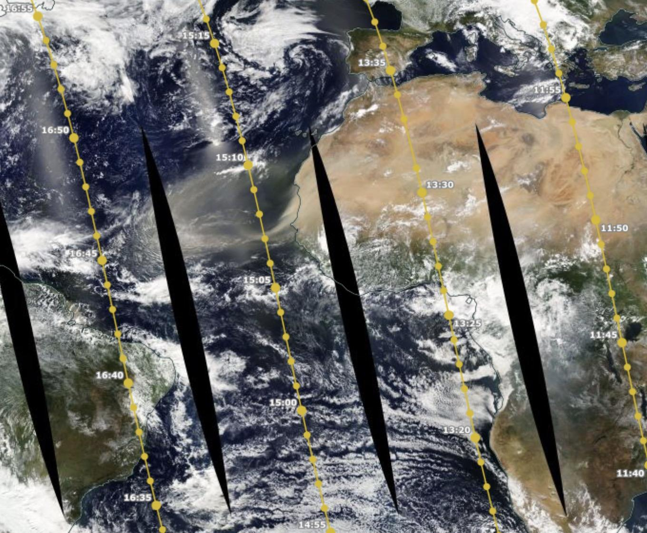
Collocating Data
Already have collocated data for CALIPSO and MODIS level-2 data
CALIPSO data tells us dust for every 5 km
MODIS data gives information for every 1 km
Took average over 5 pixels to get 5km resolution
NASA Worldview: https://go.nasa.gov/2KwnxV4
Notes:
Janita

Slide 9
Variables Utilized
Existence of dust
Radiance/Emissivity from 36 spectral bands
Geometry
Dust and clouds
Dust
Dust, no clouds
No dust or clouds
No Dust
Clouds, no dust
Notes:
Janita

Slide 10
Regions and Times Used
Northwest Coast of Africa (Atlantic Ocean)
March 13, 2007
May 9, 2007
July 15, 2007
March 31, 2008
June 22, 2009
April 22, 2010
Coast of Arabian Peninsula (Arabian Sea)
November 5, 2009
November 11, 2009
Notes:
Janita

Slide 11
Outline
Introduction
Data Preparation
Our Algorithms
Conclusion
Notes:
Qianqian

Slide 12
Simple Physical Algorithm
Ackerman¹ showed that BTD(11-12um) of dust is smaller than that of clouds
Our physical algorithm:
BTD < threshold : dust
BTD > threshold : dust-free
Threshold selection:
Applied different threshold for MODIS data along CALIPSO track
Calculated accuracy for different threshold with CALIPSO dust detection as reference
Found threshold ~ 0.8 gives highest accuracy around 60%~70%
¹Ackerman, Steven A. "Remote sensing aerosols using satellite infrared observations." Journal of Geophysical Research: Atmospheres 102.D14 (1997): 17069-17079.
Notes:
Qianqian

Slide 13
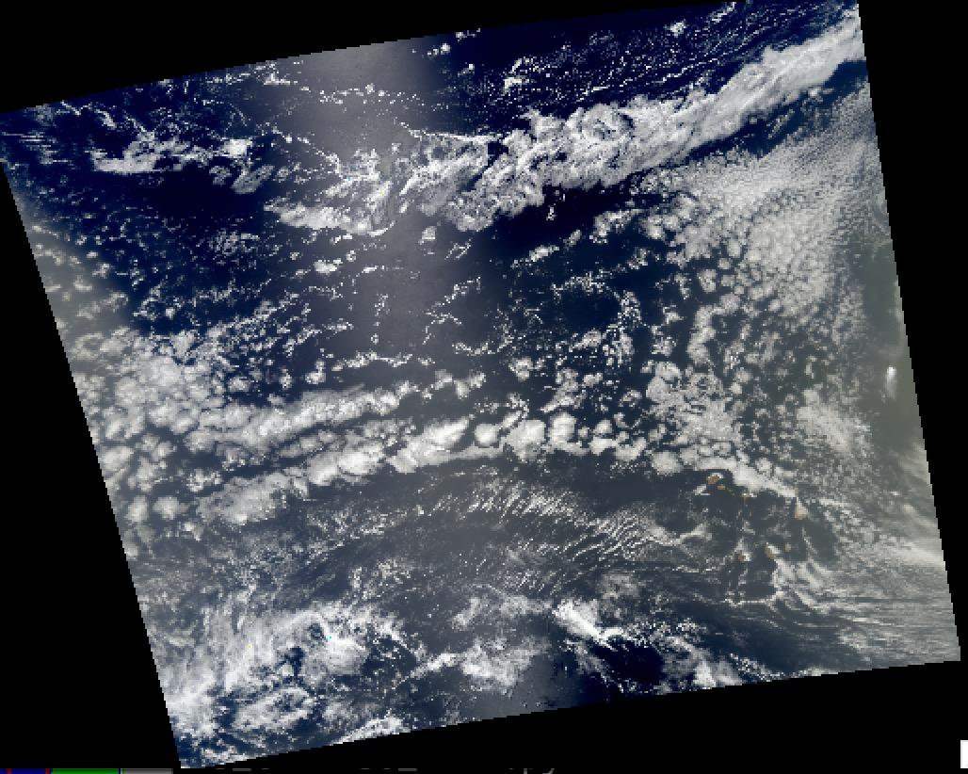
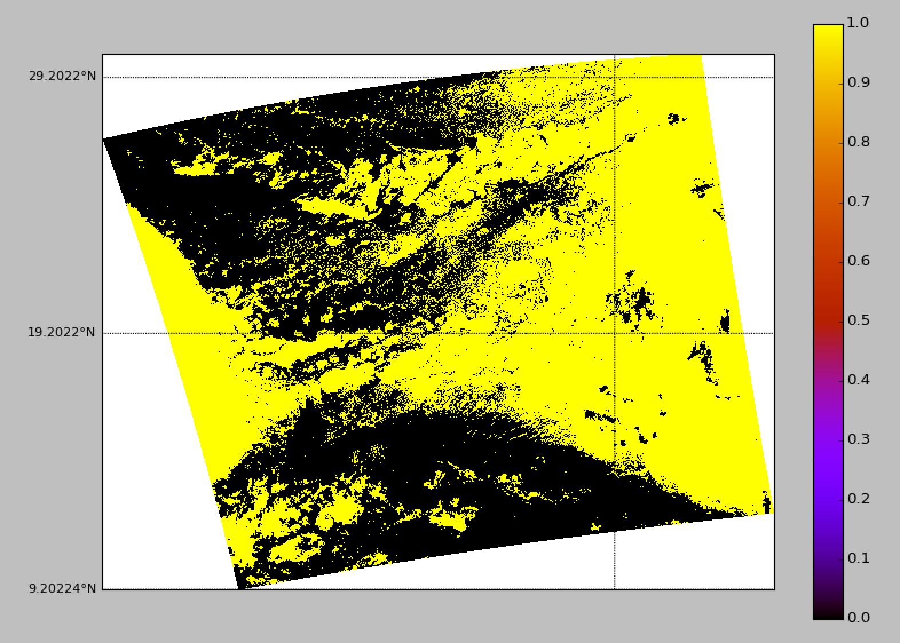
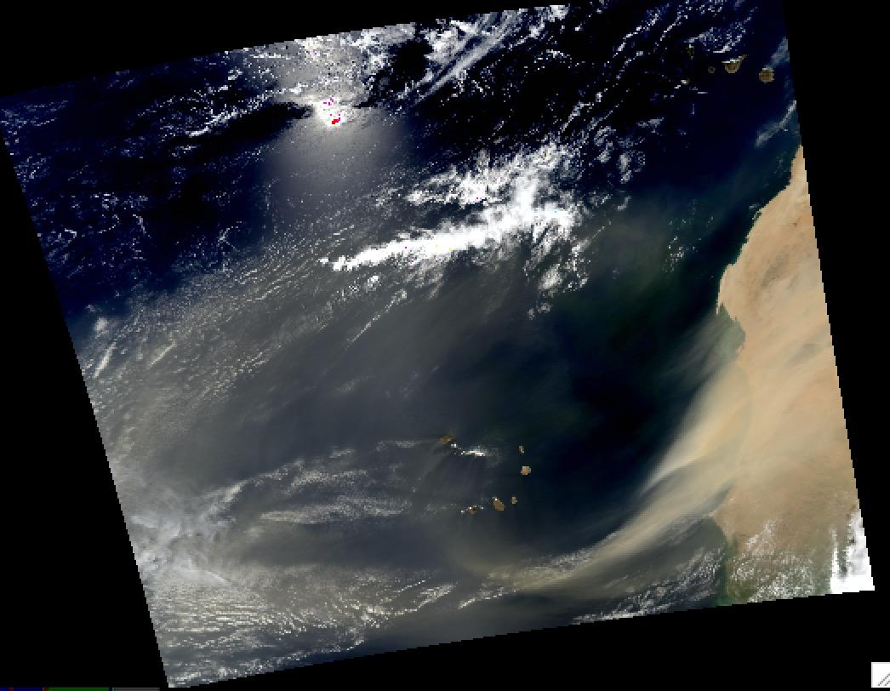
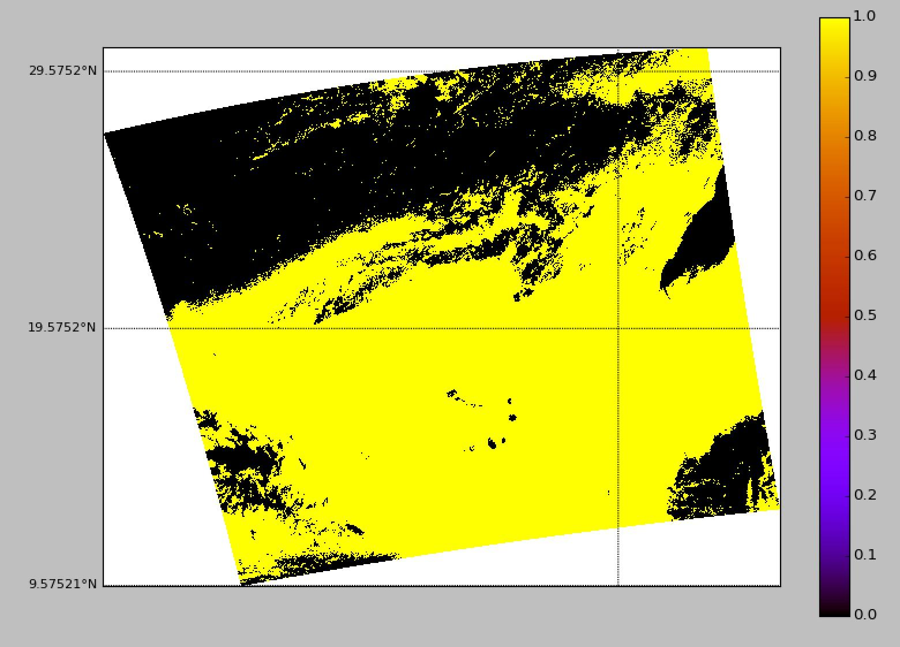
Results of Physical Algorithm
Use threshold = 0.8
July 15, 2007
Use threshold = 0.8
June 22, 2009
Notes:
Qianqian

Slide 14
Machine Learning Method: Logistic Regression
Summary of method
More intuitive and robust than other regressions
Not many assumptions needed
Goal is to select best set of predictor variables and create a model for outcome variable
Types of simulations run
Using all variables
Using 6 variables
R0.47
R0.47/R0.64
BTD(3.9um-11um)
BTD(11-12um)
R0.42um, R0.68
Using 6 variables with geometry
Notes:
Qianqian

Slide 15
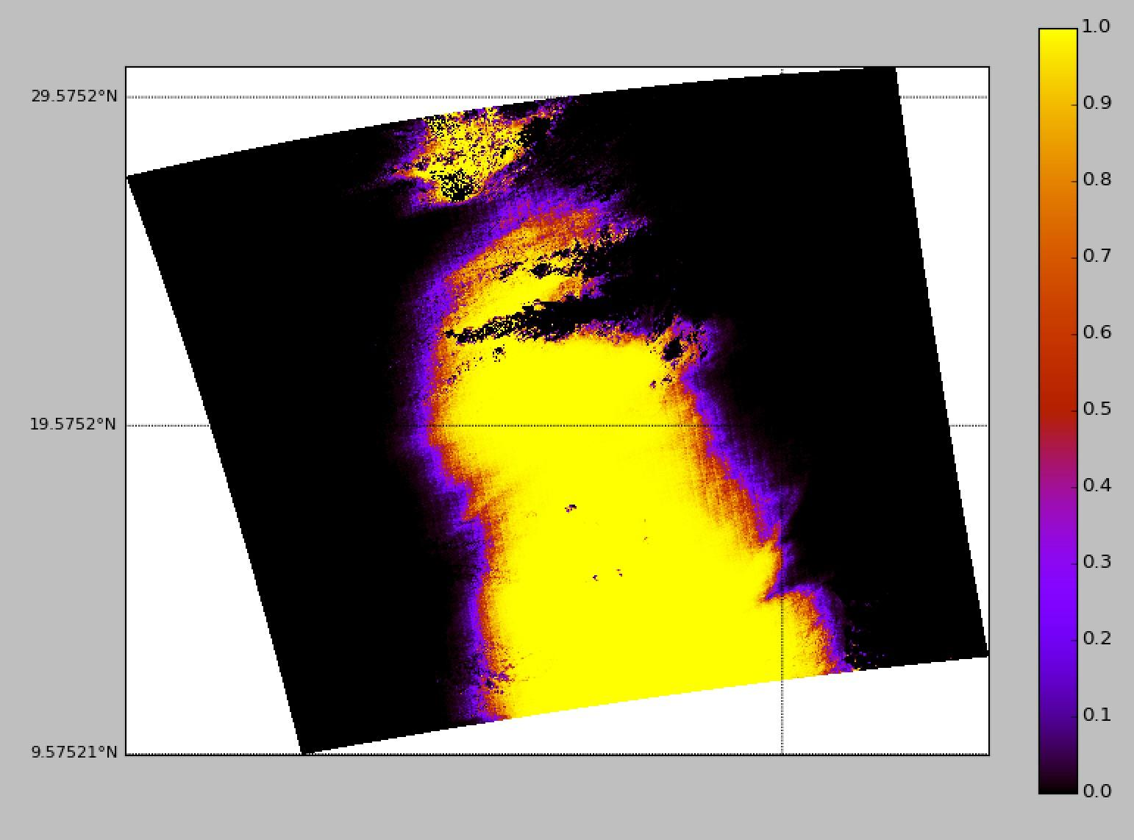
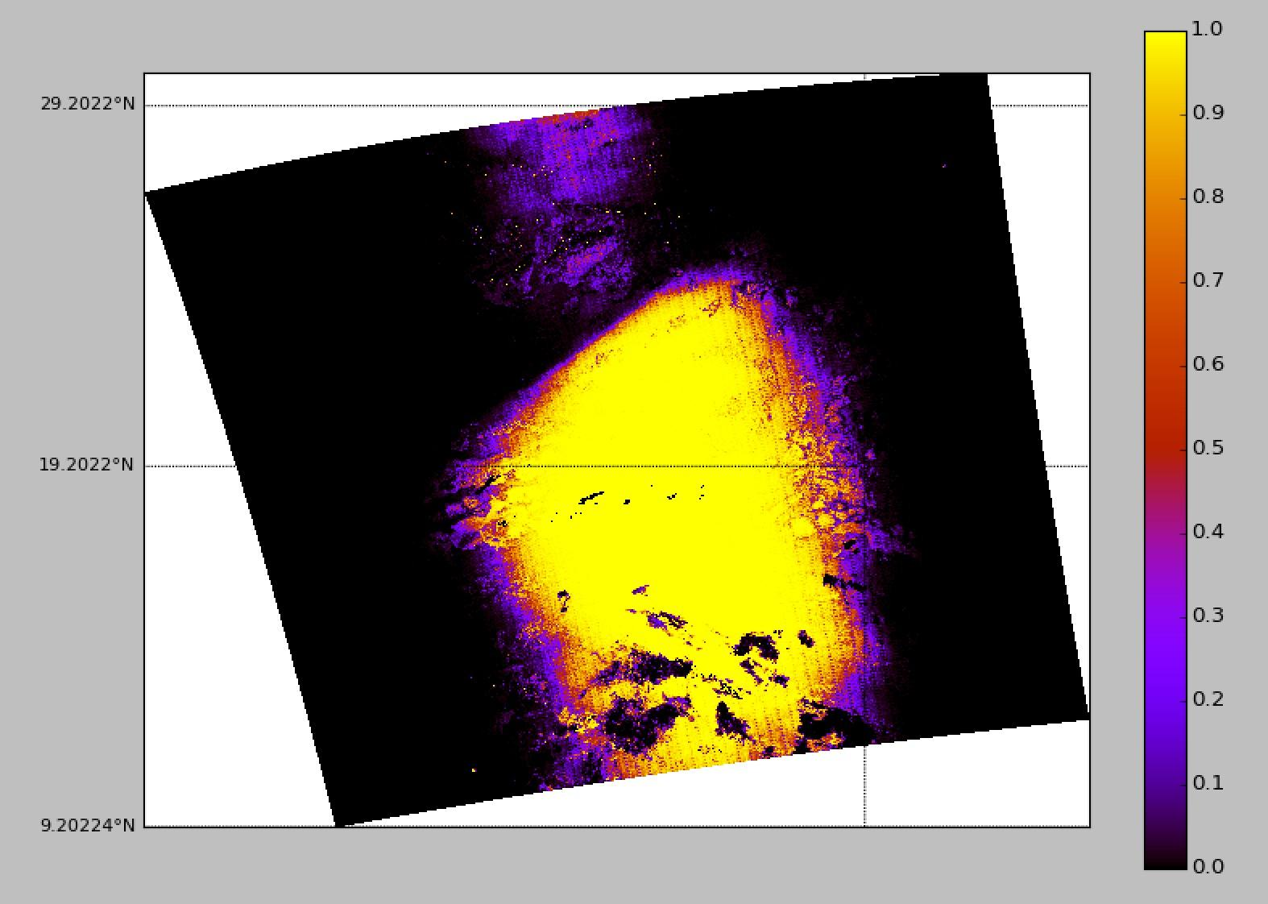
Logistic Regression Results: All Variables
June 22, 2009
July 15, 2007

Slide 16
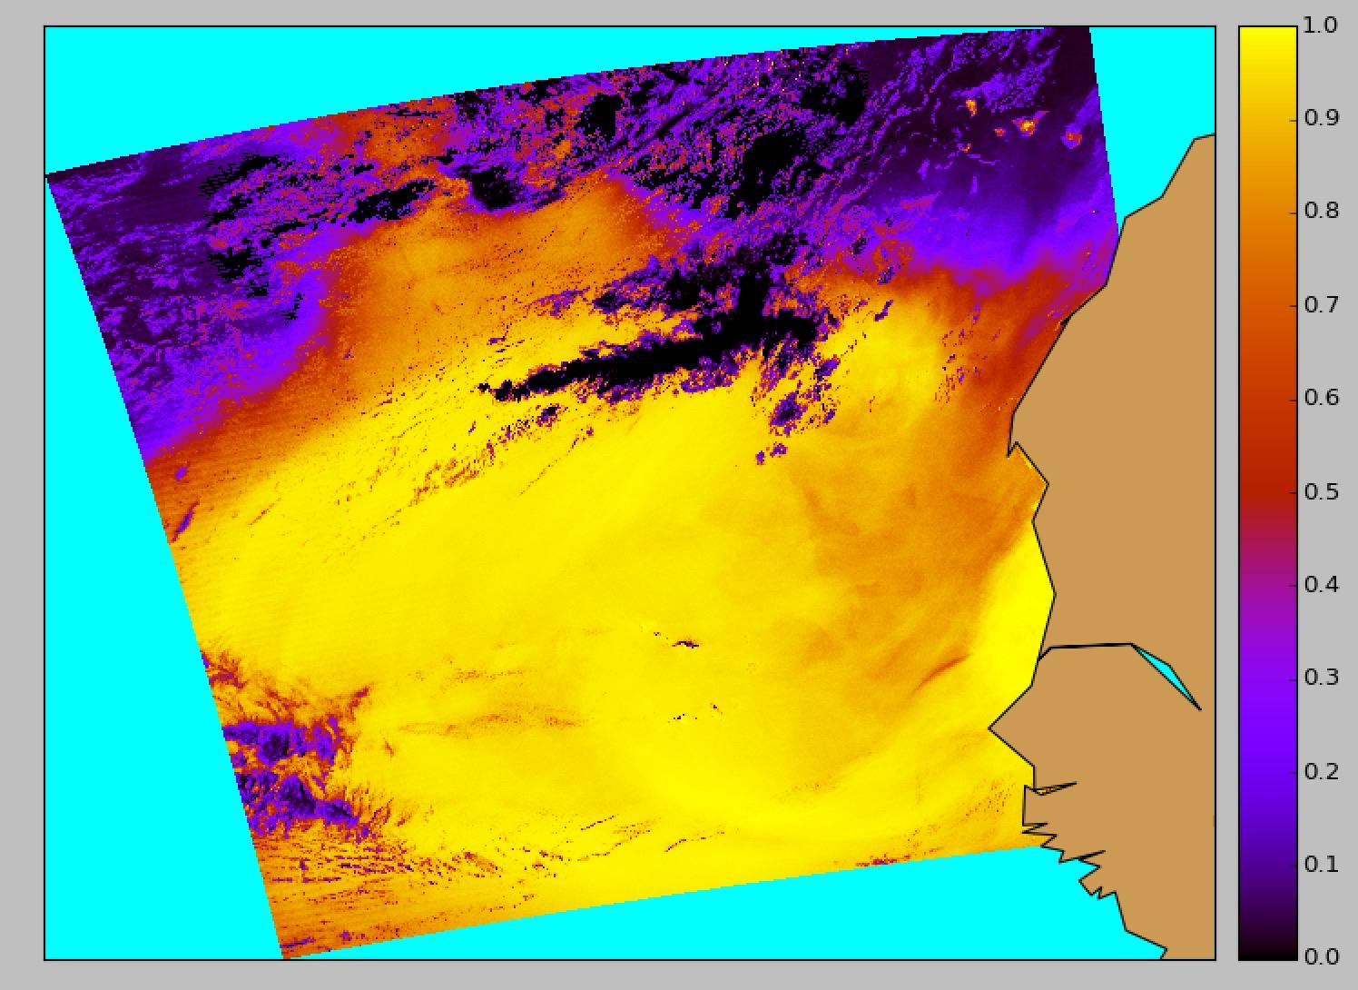
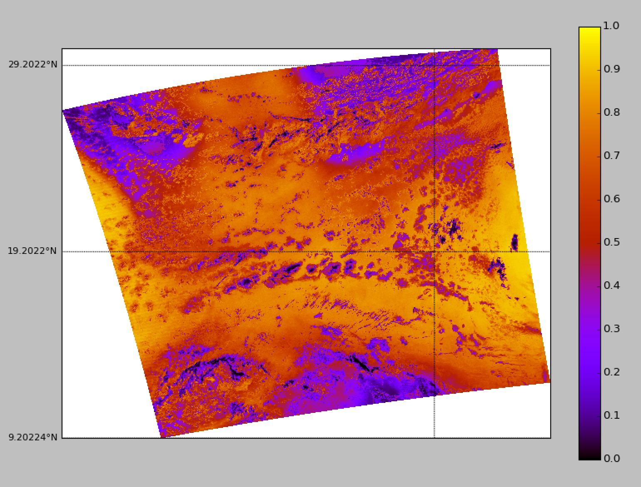
Logistic Regression Results: 6 Variables
R0.47
R0.47/R0.64
BTD(3.9um-11um)
BTD(11-12um)
R0.42um, R0.68

Slide 17
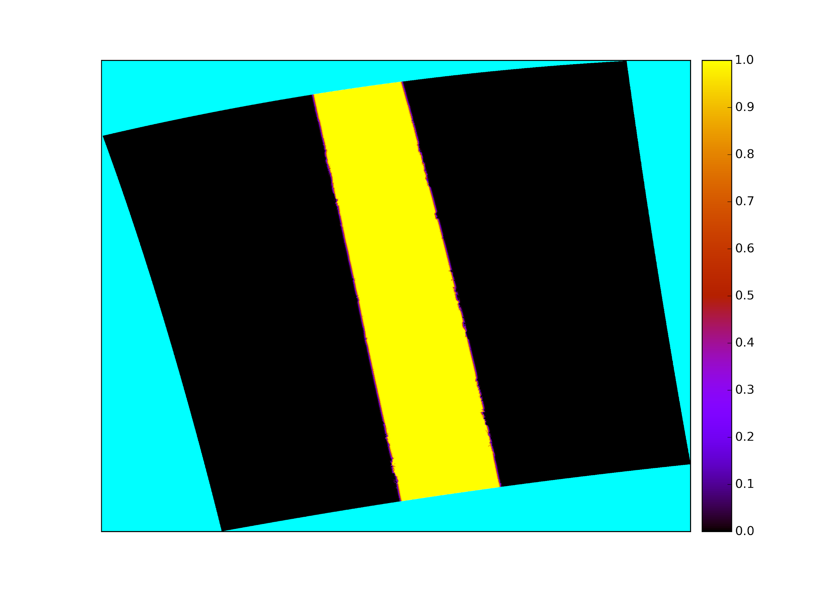
Logistic Regression Results: 6 Variables and Geometry
June 22, 2009

Slide 18
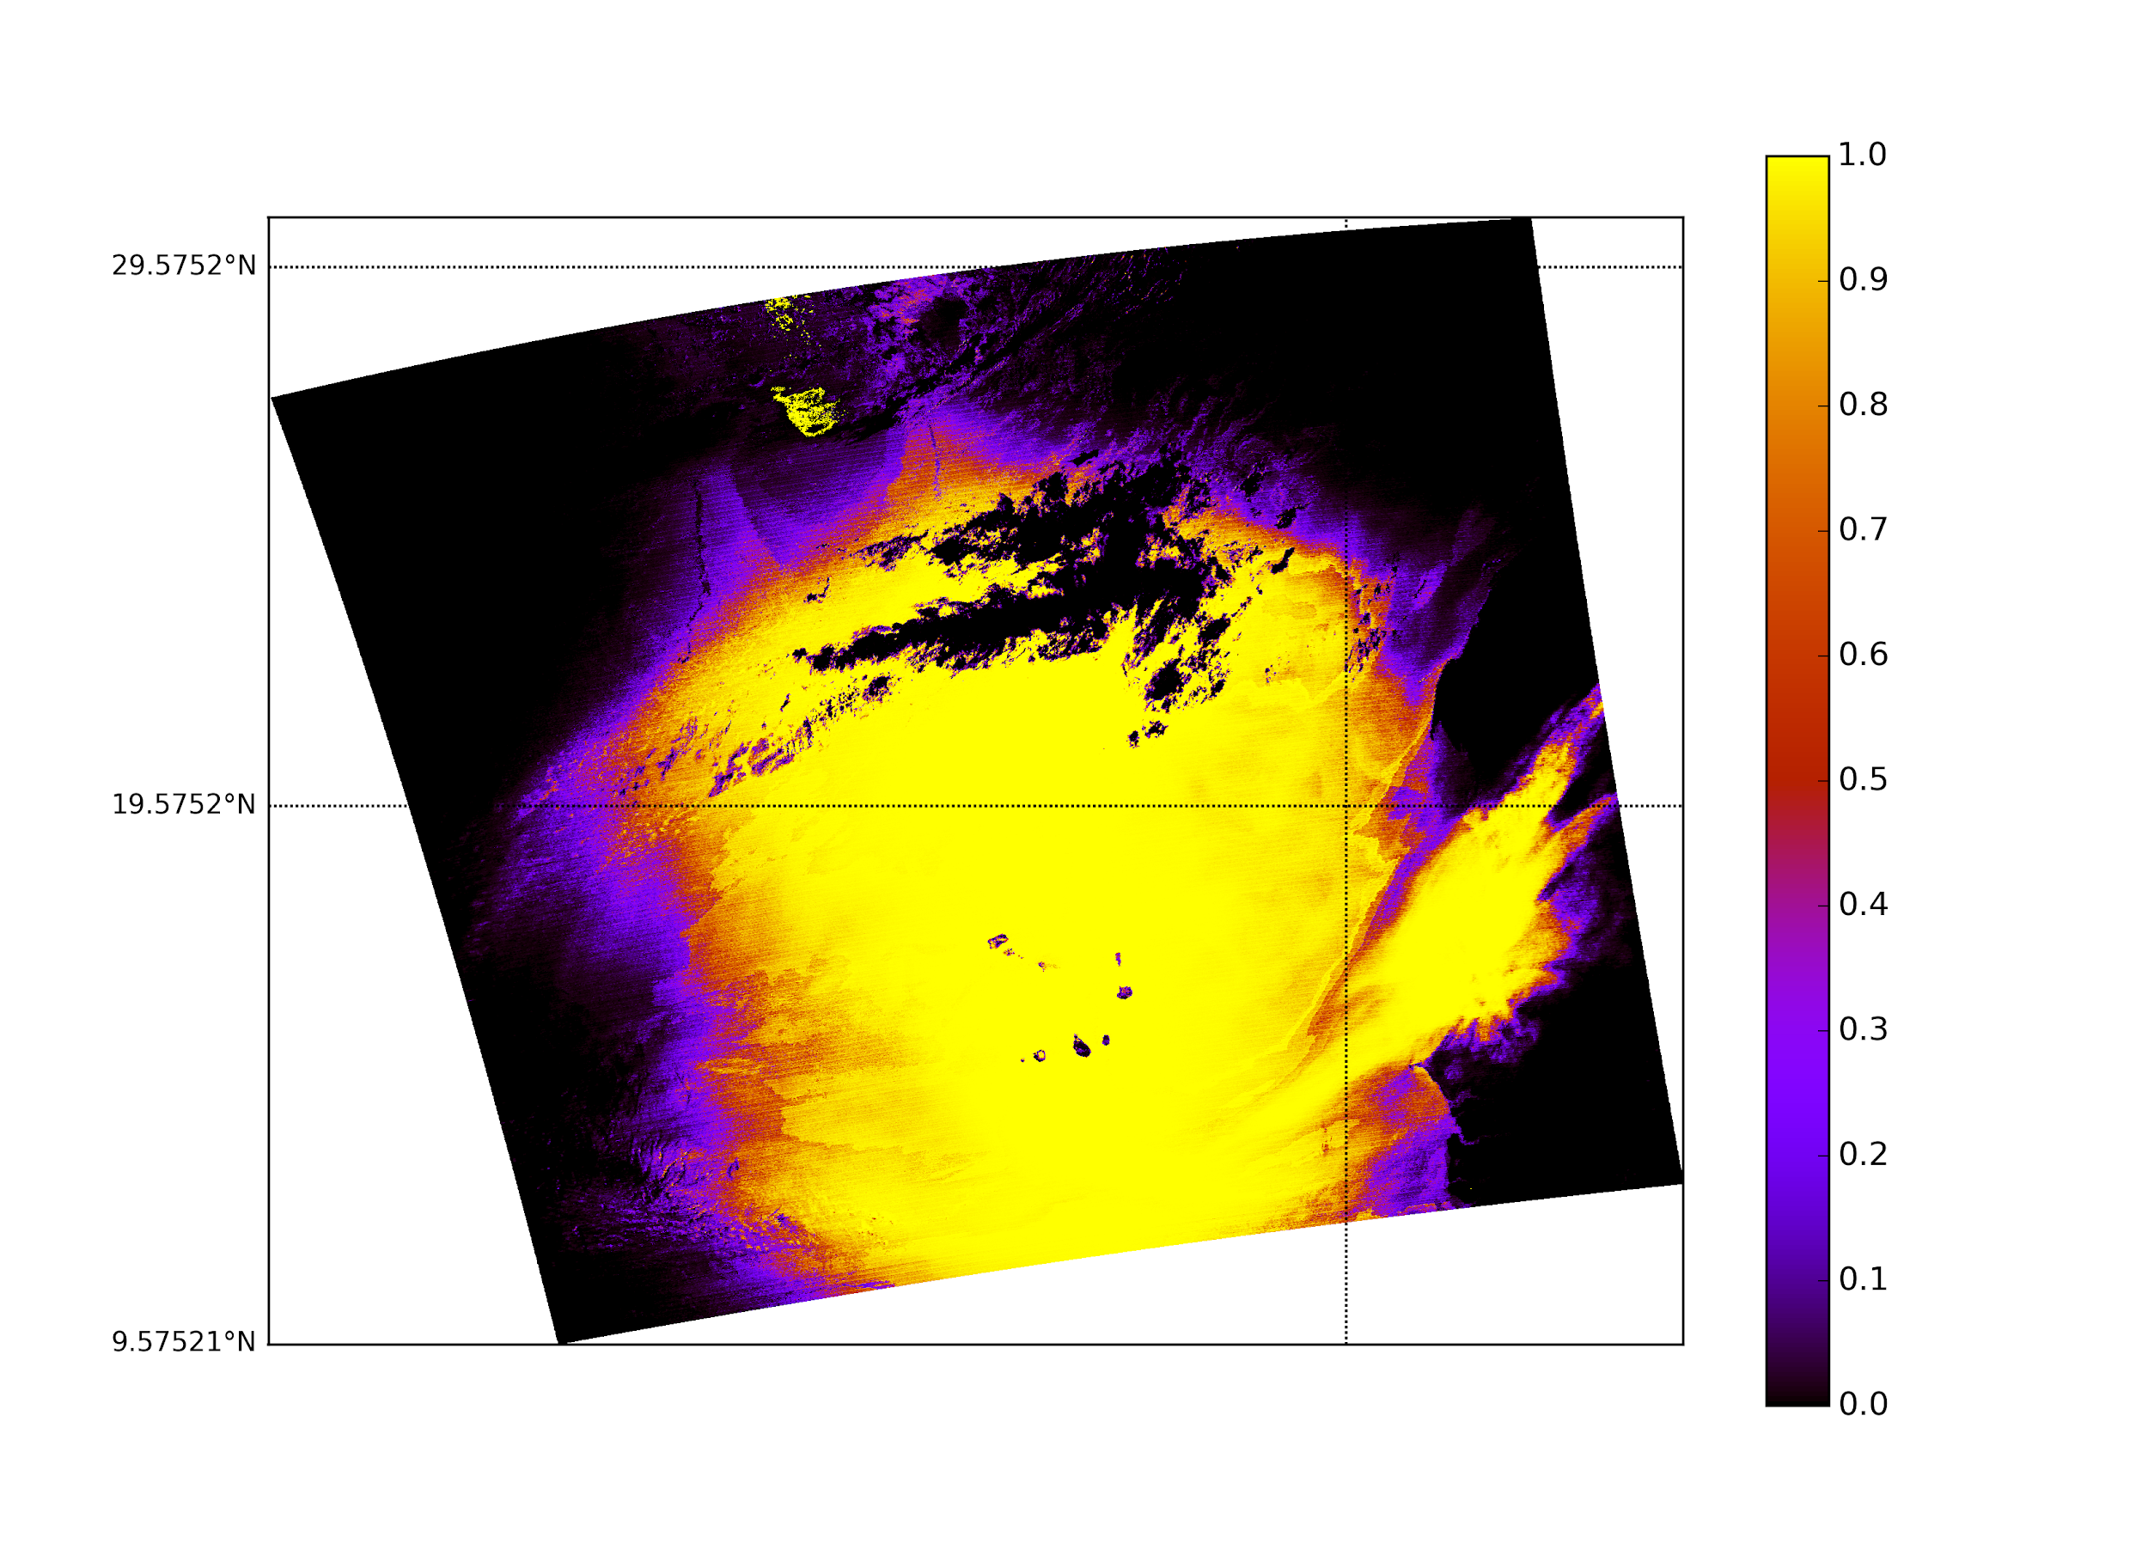
Logistic Regression Results: Multiple Data Sets with All Band variables
June 22, 2009

Slide 19
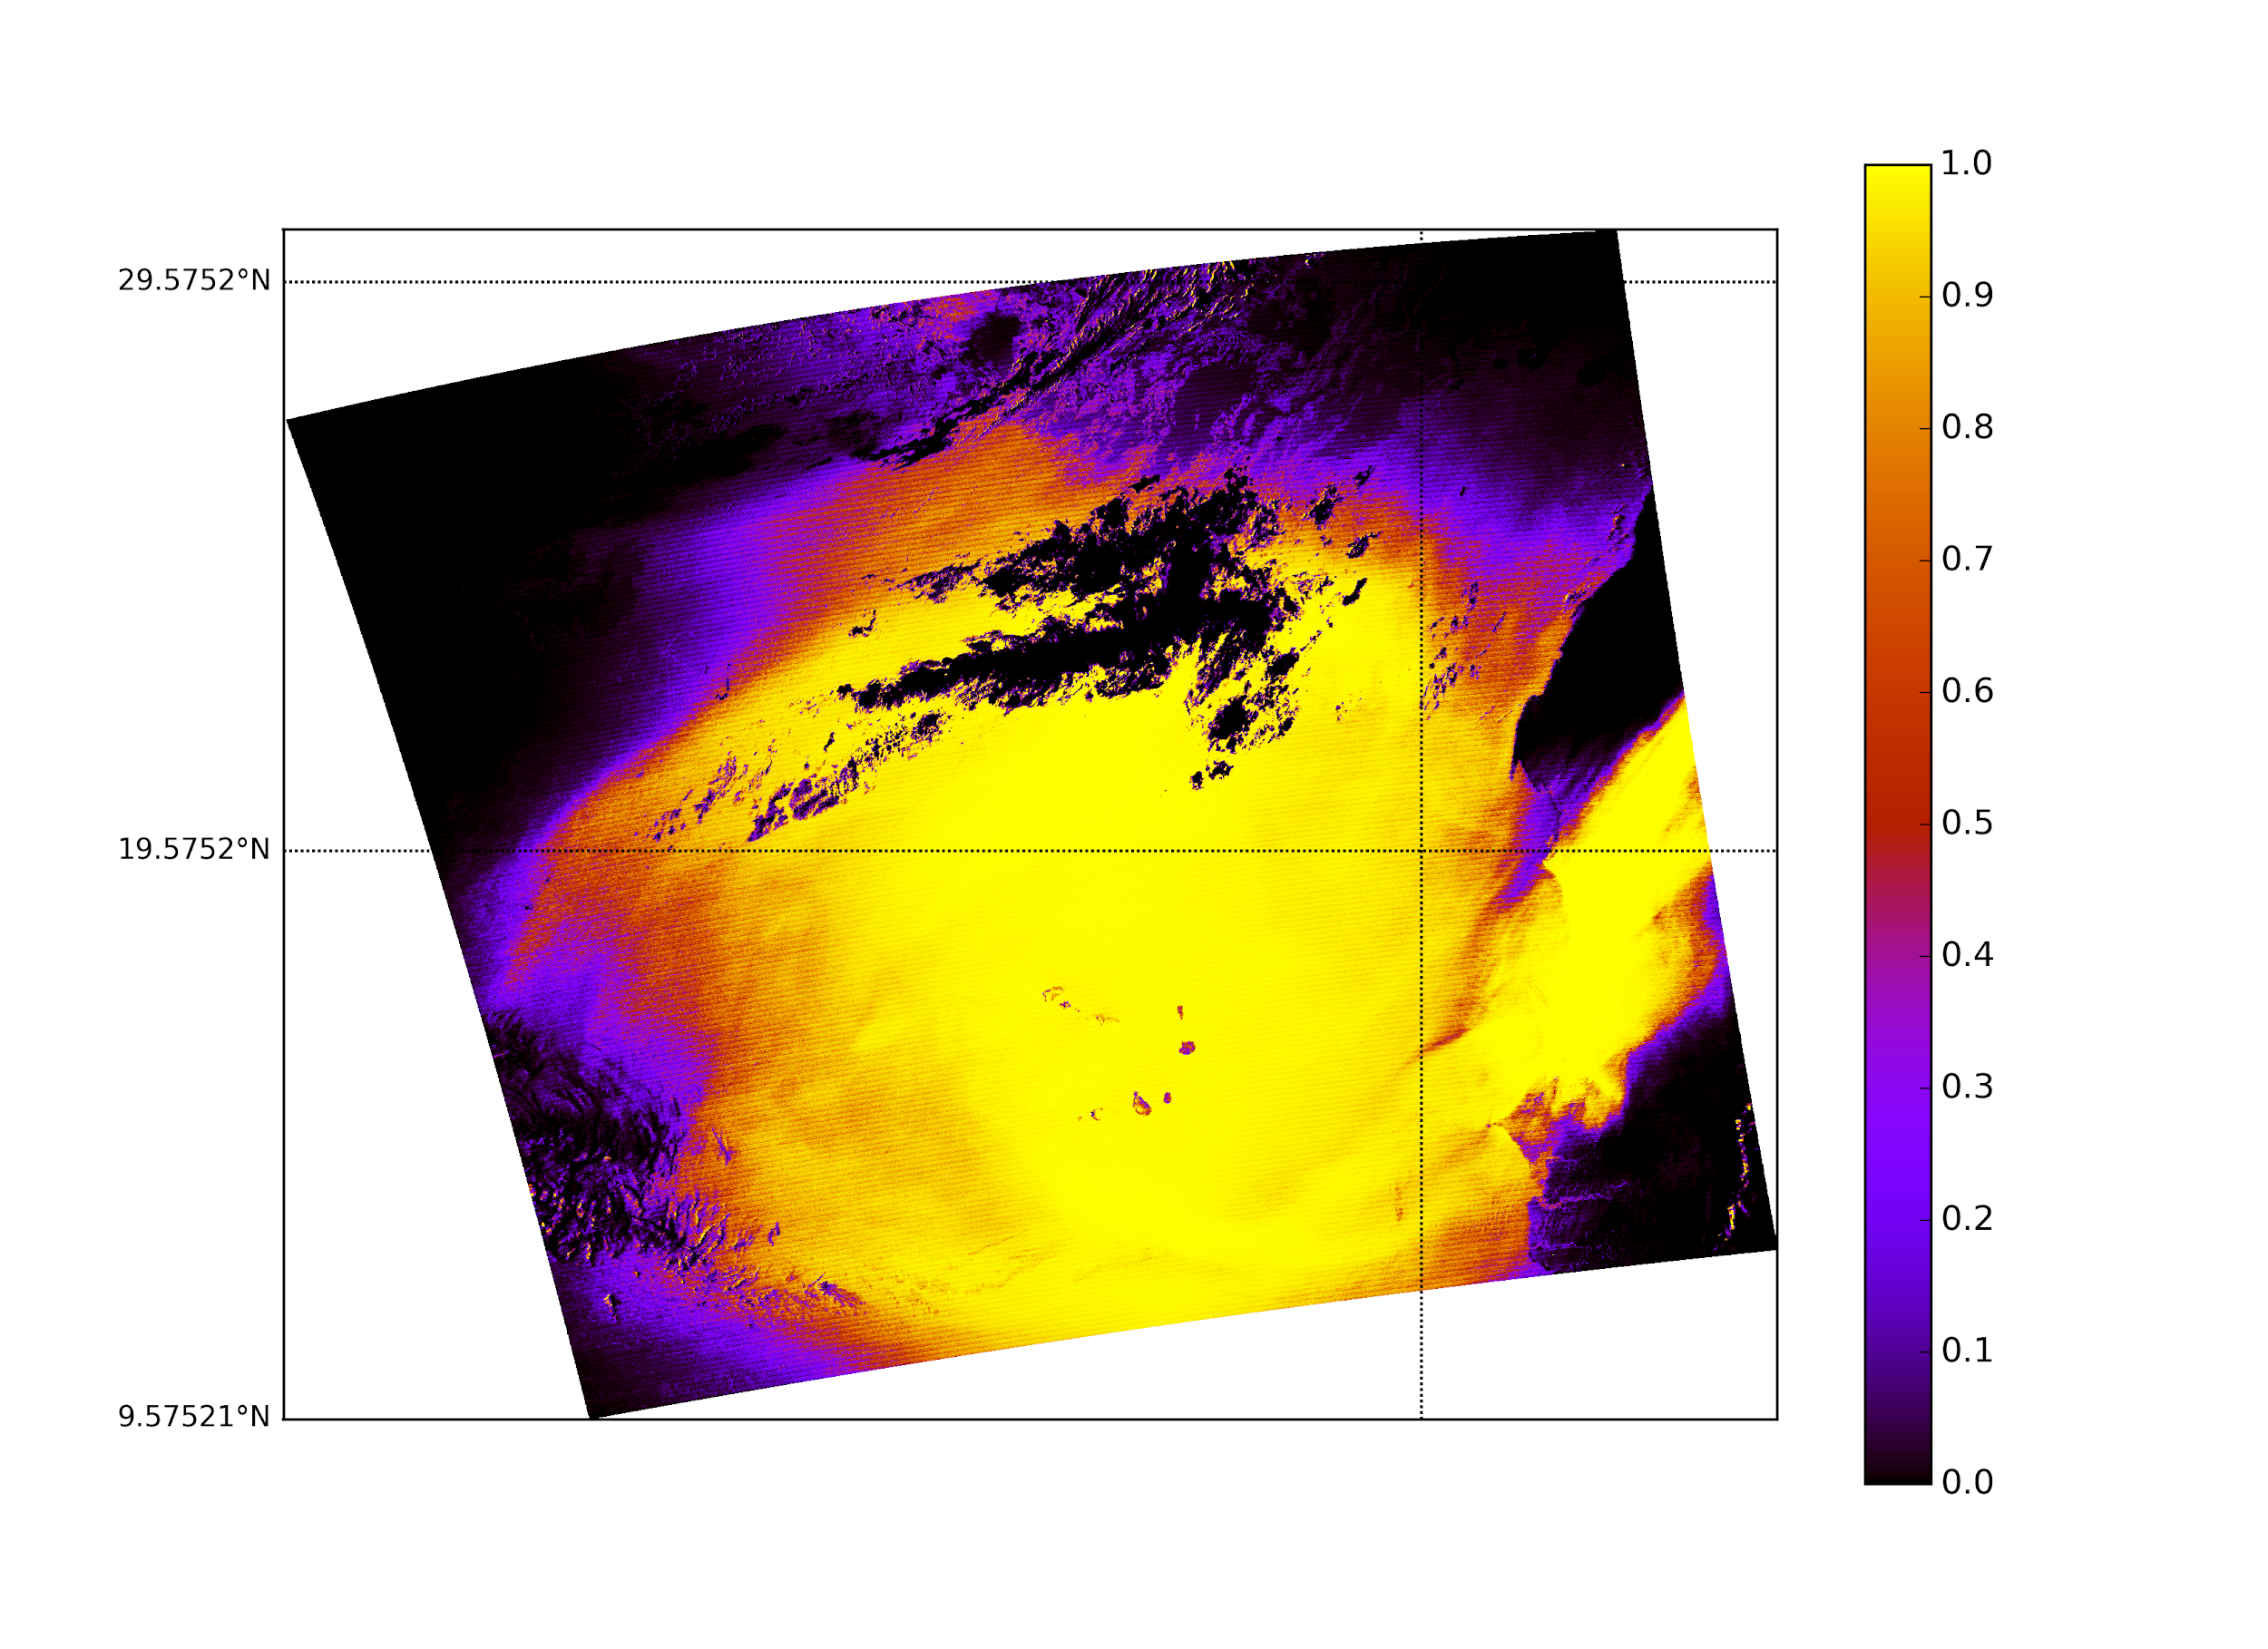
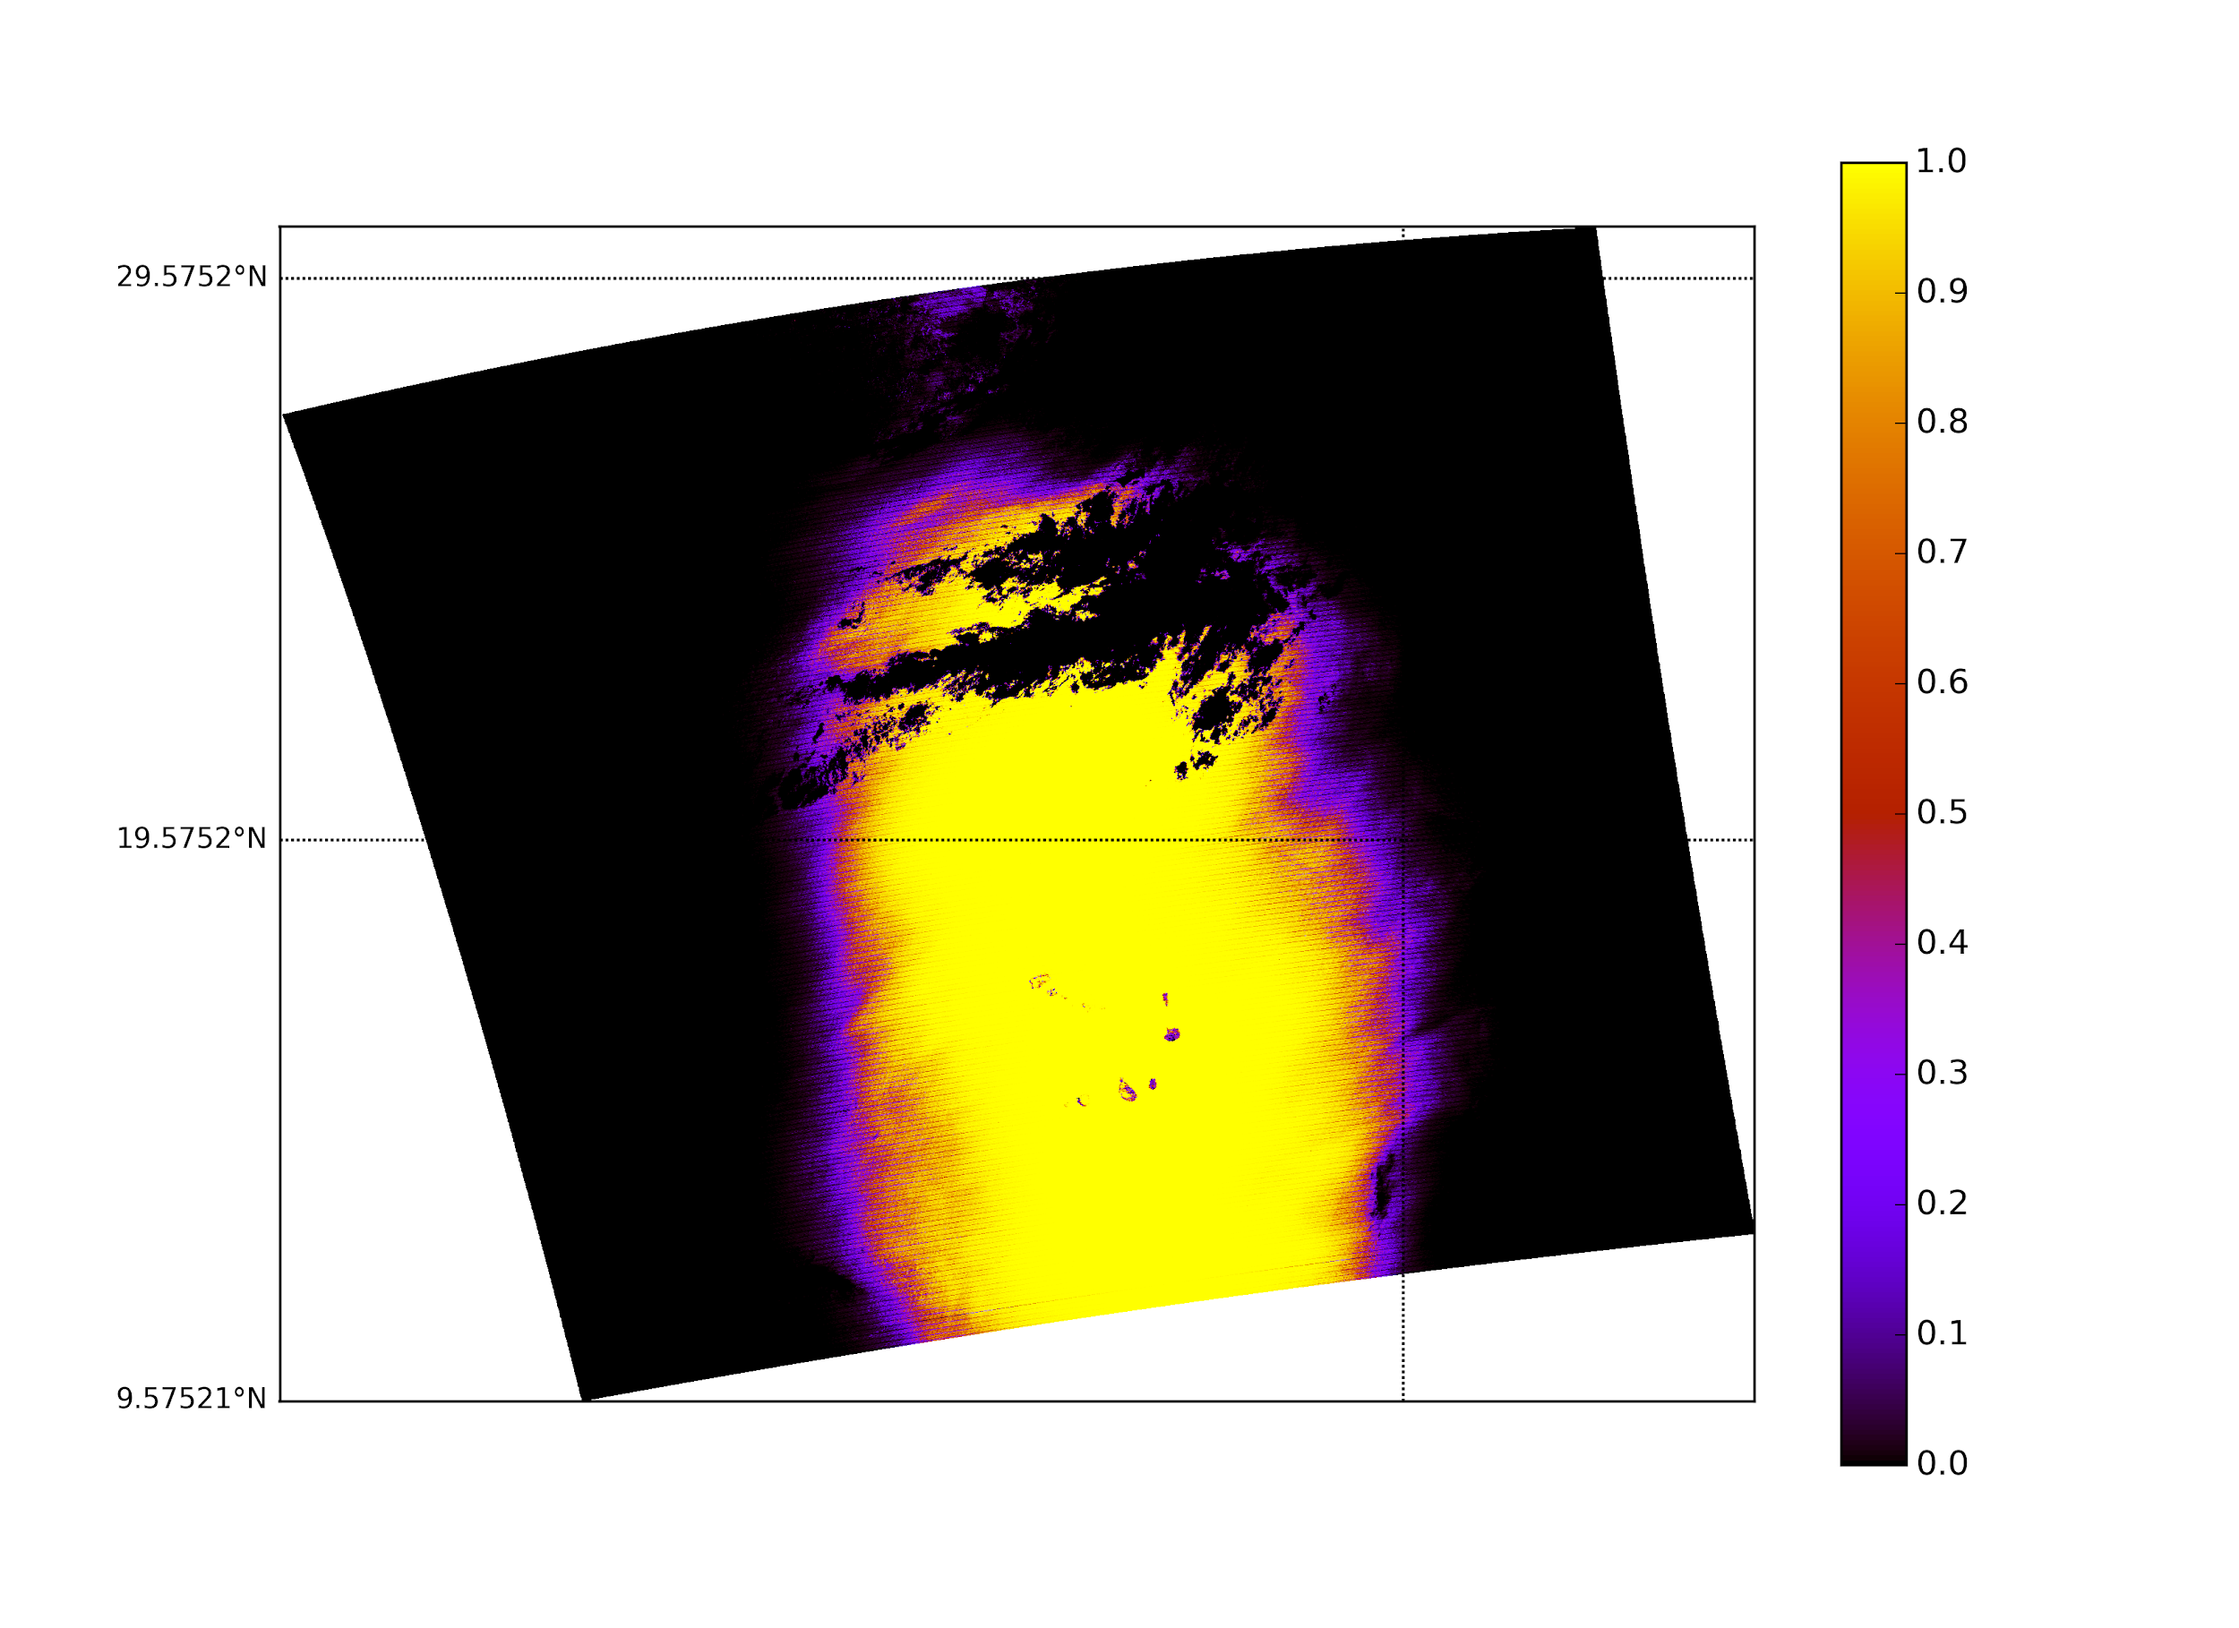
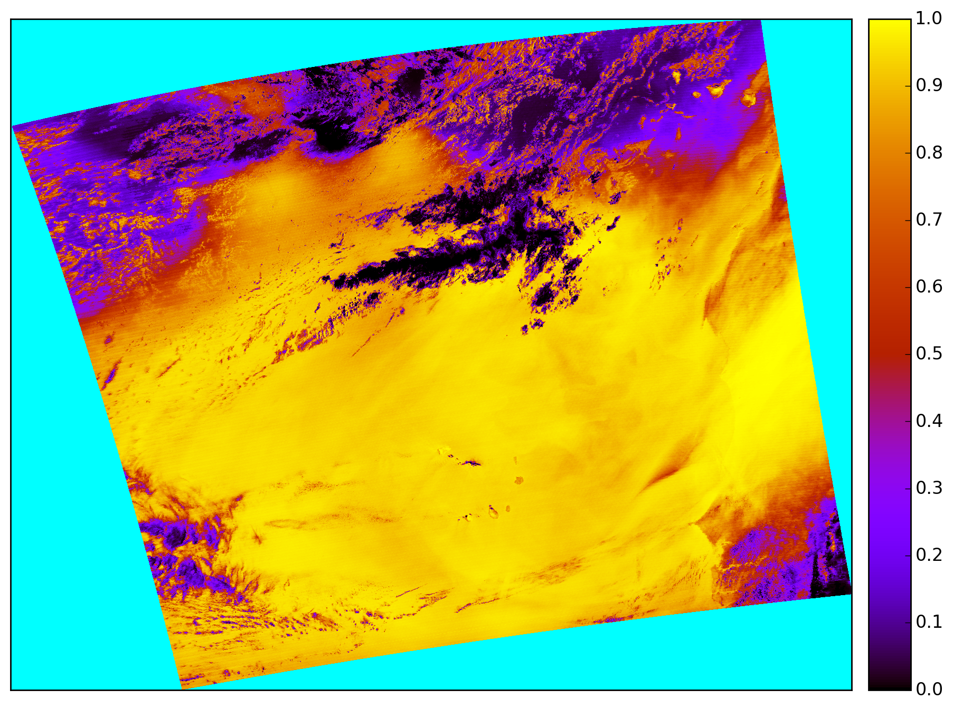
Multiple data vs Single data
Multiple dataset with parsimonious variables
Multiple data with 6 variables
Sing dataset with parsimonious variables

Slide 20
Outline
Introduction
Data Preparation
Our Algorithms
Conclusion

Slide 21
Accuracy Comparison: July 15, 2007
 | Accuracy Rate | False Positive | False Negative
Physical Algorithm | 50.8% | 44.6% | 4.6%
LR- All variables | 90.5% | 2.1% | 7.4%
LR- 6 variables | 78.3% | 6.6% | 15.1%
LR- 6 variables and geometry | 81.7% | 7.5% | 10.8%
LR- Multiple data sets, all variables and geometry | 92.4% | 2% | 5.6%
LR-Multiple datasets, parsimonious model | 89.5% | 2% | 8.4%
LR single dataset , parsimonious model | 93.2% | 1.7% | 5.1%

Slide 22
Future Work
Try other machine learning techniques for the machine learning algorithm
Create an algorithm for detecting dust over land
Combine land and ocean algorithms
Decrease false positive and negative rates
Compare accuracy rates to those of published algorithms

Slide 23
Thank You!

